Slide 1
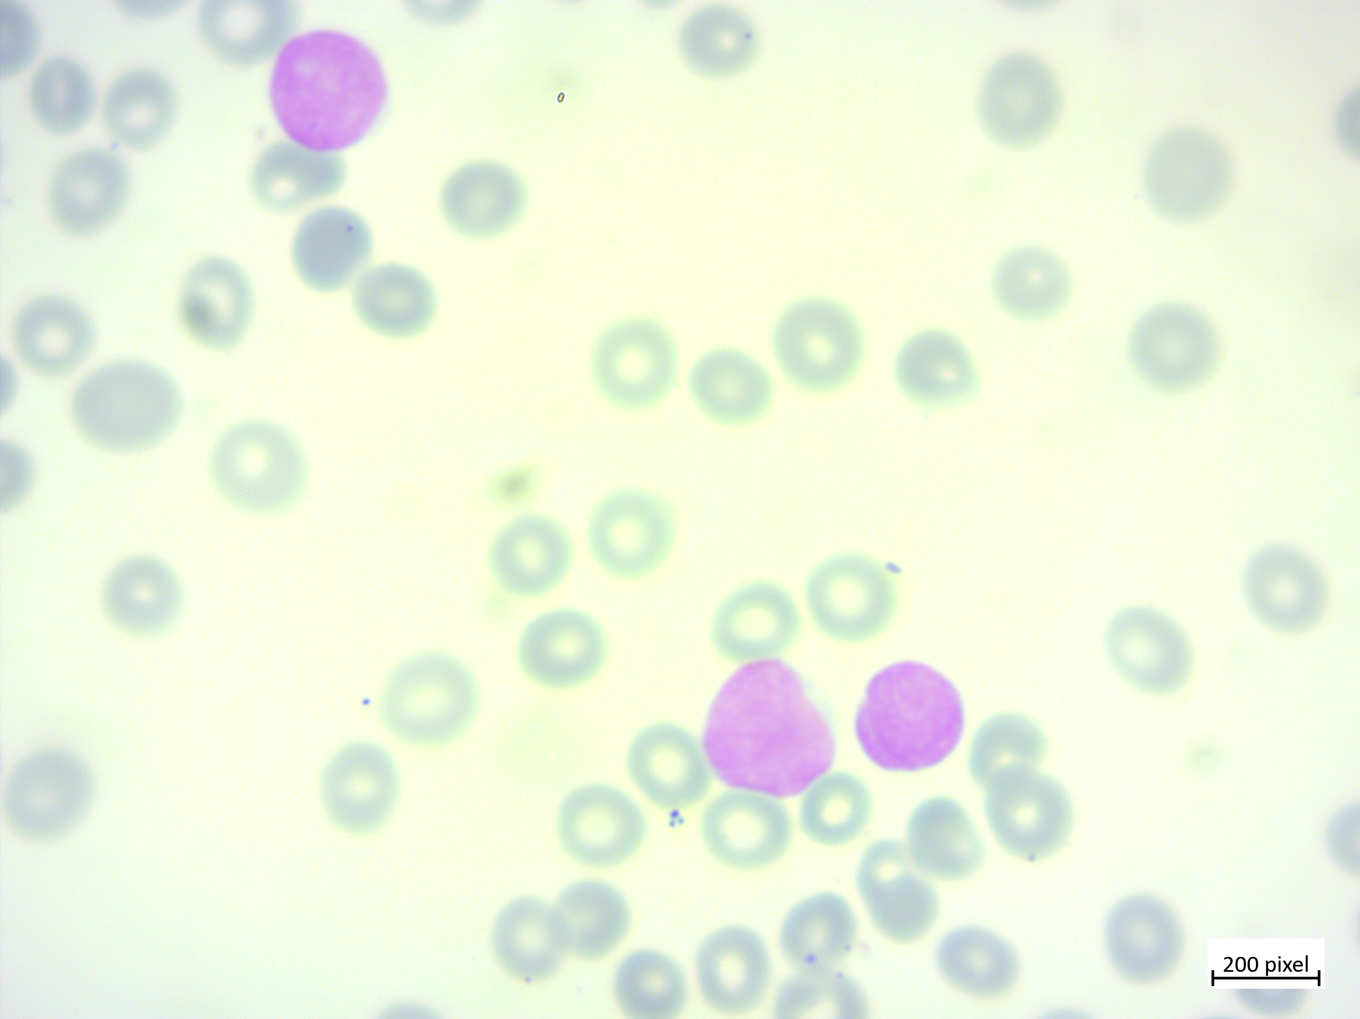

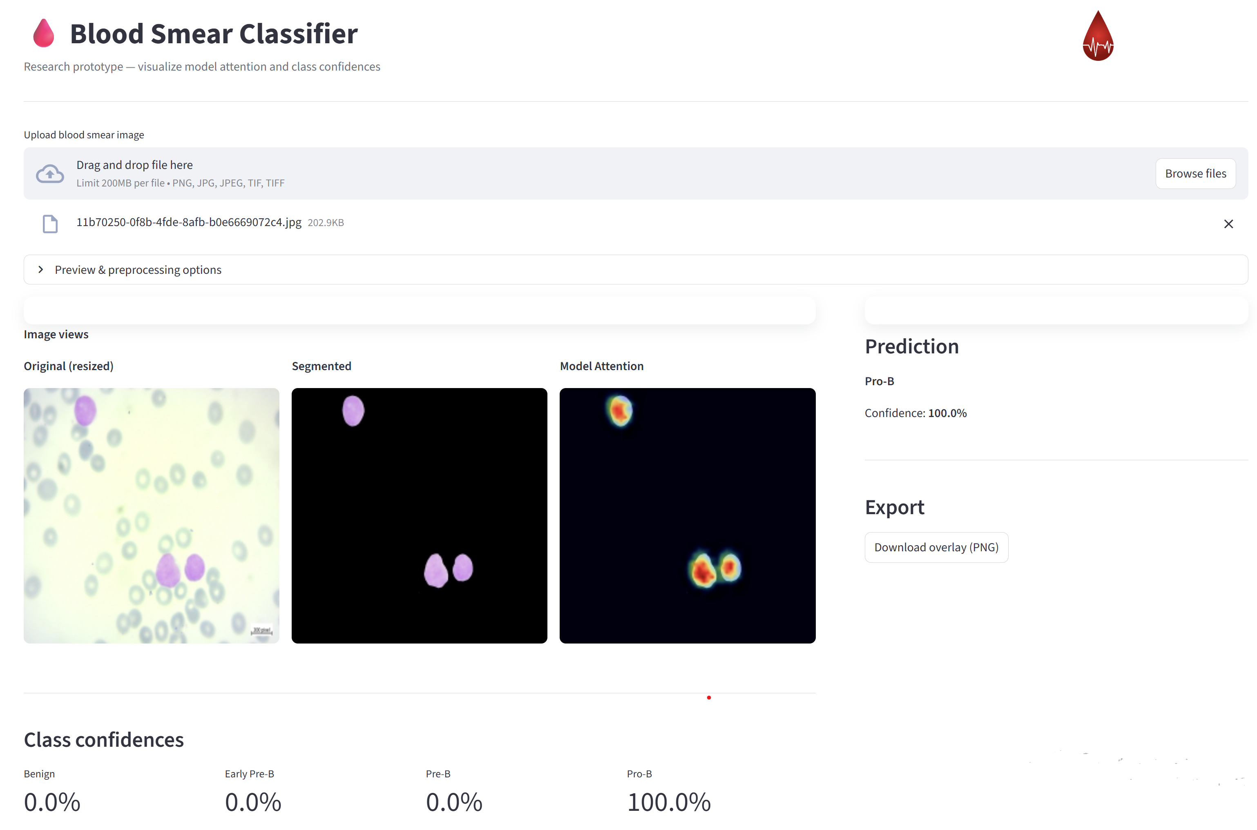
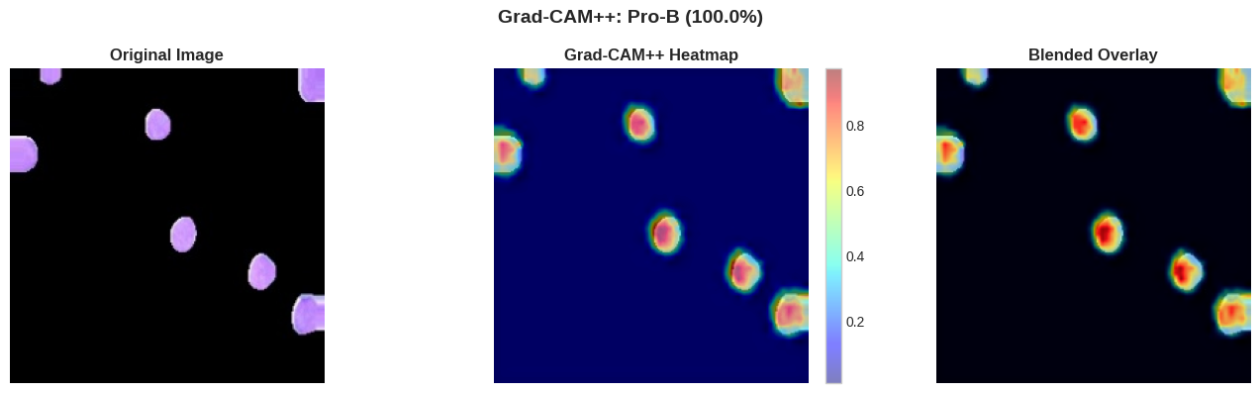
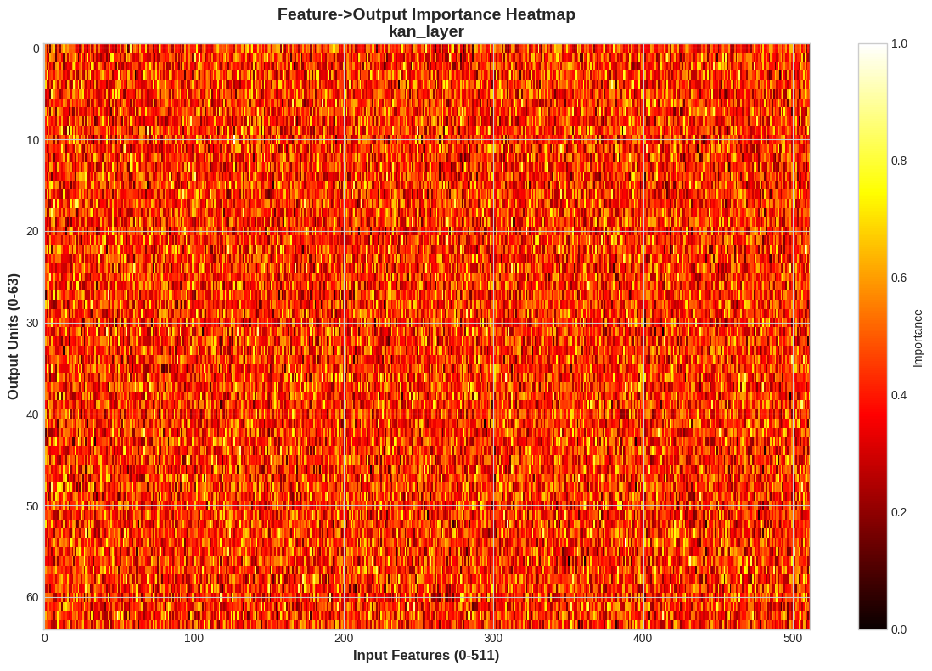
Comprehensive Image Augmentation (flip, rotate, scale, crop, color & noise variations) for Class Balance
Preprocessing
Color-threshold segmentation
H&E stain normalization
H-separation
E-separation
Resize Image
Kaggle Aria ALL 4-class Dataset
Min-Max Scaling
Input: 224×224×3
Publicly deployed Prototype
Grad-CAM++ and KAN
Feature-Importance Analysis
Proposed ResSplit-KAN Model
Stem Conv
Res2 + SE Backbone (Multi-scale Residual)
Faster Medical Attention
CBAM Attention
Results
KAN Layers
Best preprocessing: Color-threshold segmentation → achieves 98.75% test accuracy (95% CI: 97.87–99.37%) and 99.98% AUC.
ResSplit-KAN performance: Outperforms DenseNet121, MobileNetV2, NASNetMobile, and EfficientNetV2B1 while using only 1.62M parameters.

Slide 2
Input: 224×224×3
ResSplit Block
Stem Conv
Conv2D
(1×1, act=GeLU)
Conv2D
(3×3, stride 2)
Split Into s group then concatanate
Batch Normalization
×2
Conv2D
(1×1, act=Linear)
Input
(batch, input_dim)
Activation = GeLU
Scequeeze and Excitetaion Bock
MatMul (x ⊗ w)
Grid Center (0..1)
(1, Grid, 1)
Expand Dims
(B, 1, D)
Multi-scale Residual
ResSplitBlock
(×2)
×3
Activation GeLU
Linear out (input_dim, unit)
RBF Basic Calc exp(−(x−grid)^2)
Spline_basis (B, Grid, D)
Downsample (3×3, stride 2)
Einsum (basis, spline_w)
Feature Map
Input
Conv2D
(1×1, stride 1)
Spline_out
Weights (Grid, input_dim, unit)
Batch Normalization
Split
0
Split
1
Split
2
Split
3
Dropout
Activation = GeLU
Add
1
Add
2
Add
3
Output
conv
3×3
CBAM Attention
out
0
conv
3×3
conv
3×3
conv
3×3
KAN Layer (×2)
(64, 32 units)
out
1
out
2
out
3
Dense Layer (nc unit) SoftMax Output
Concatenated
Output

Slide 3

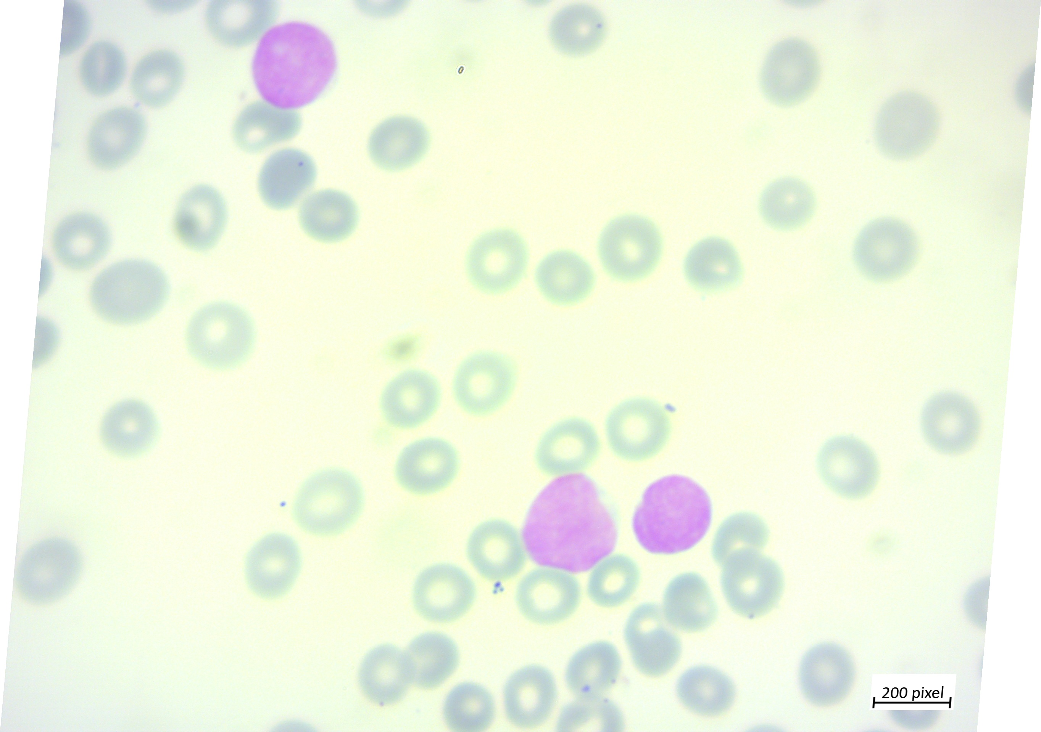
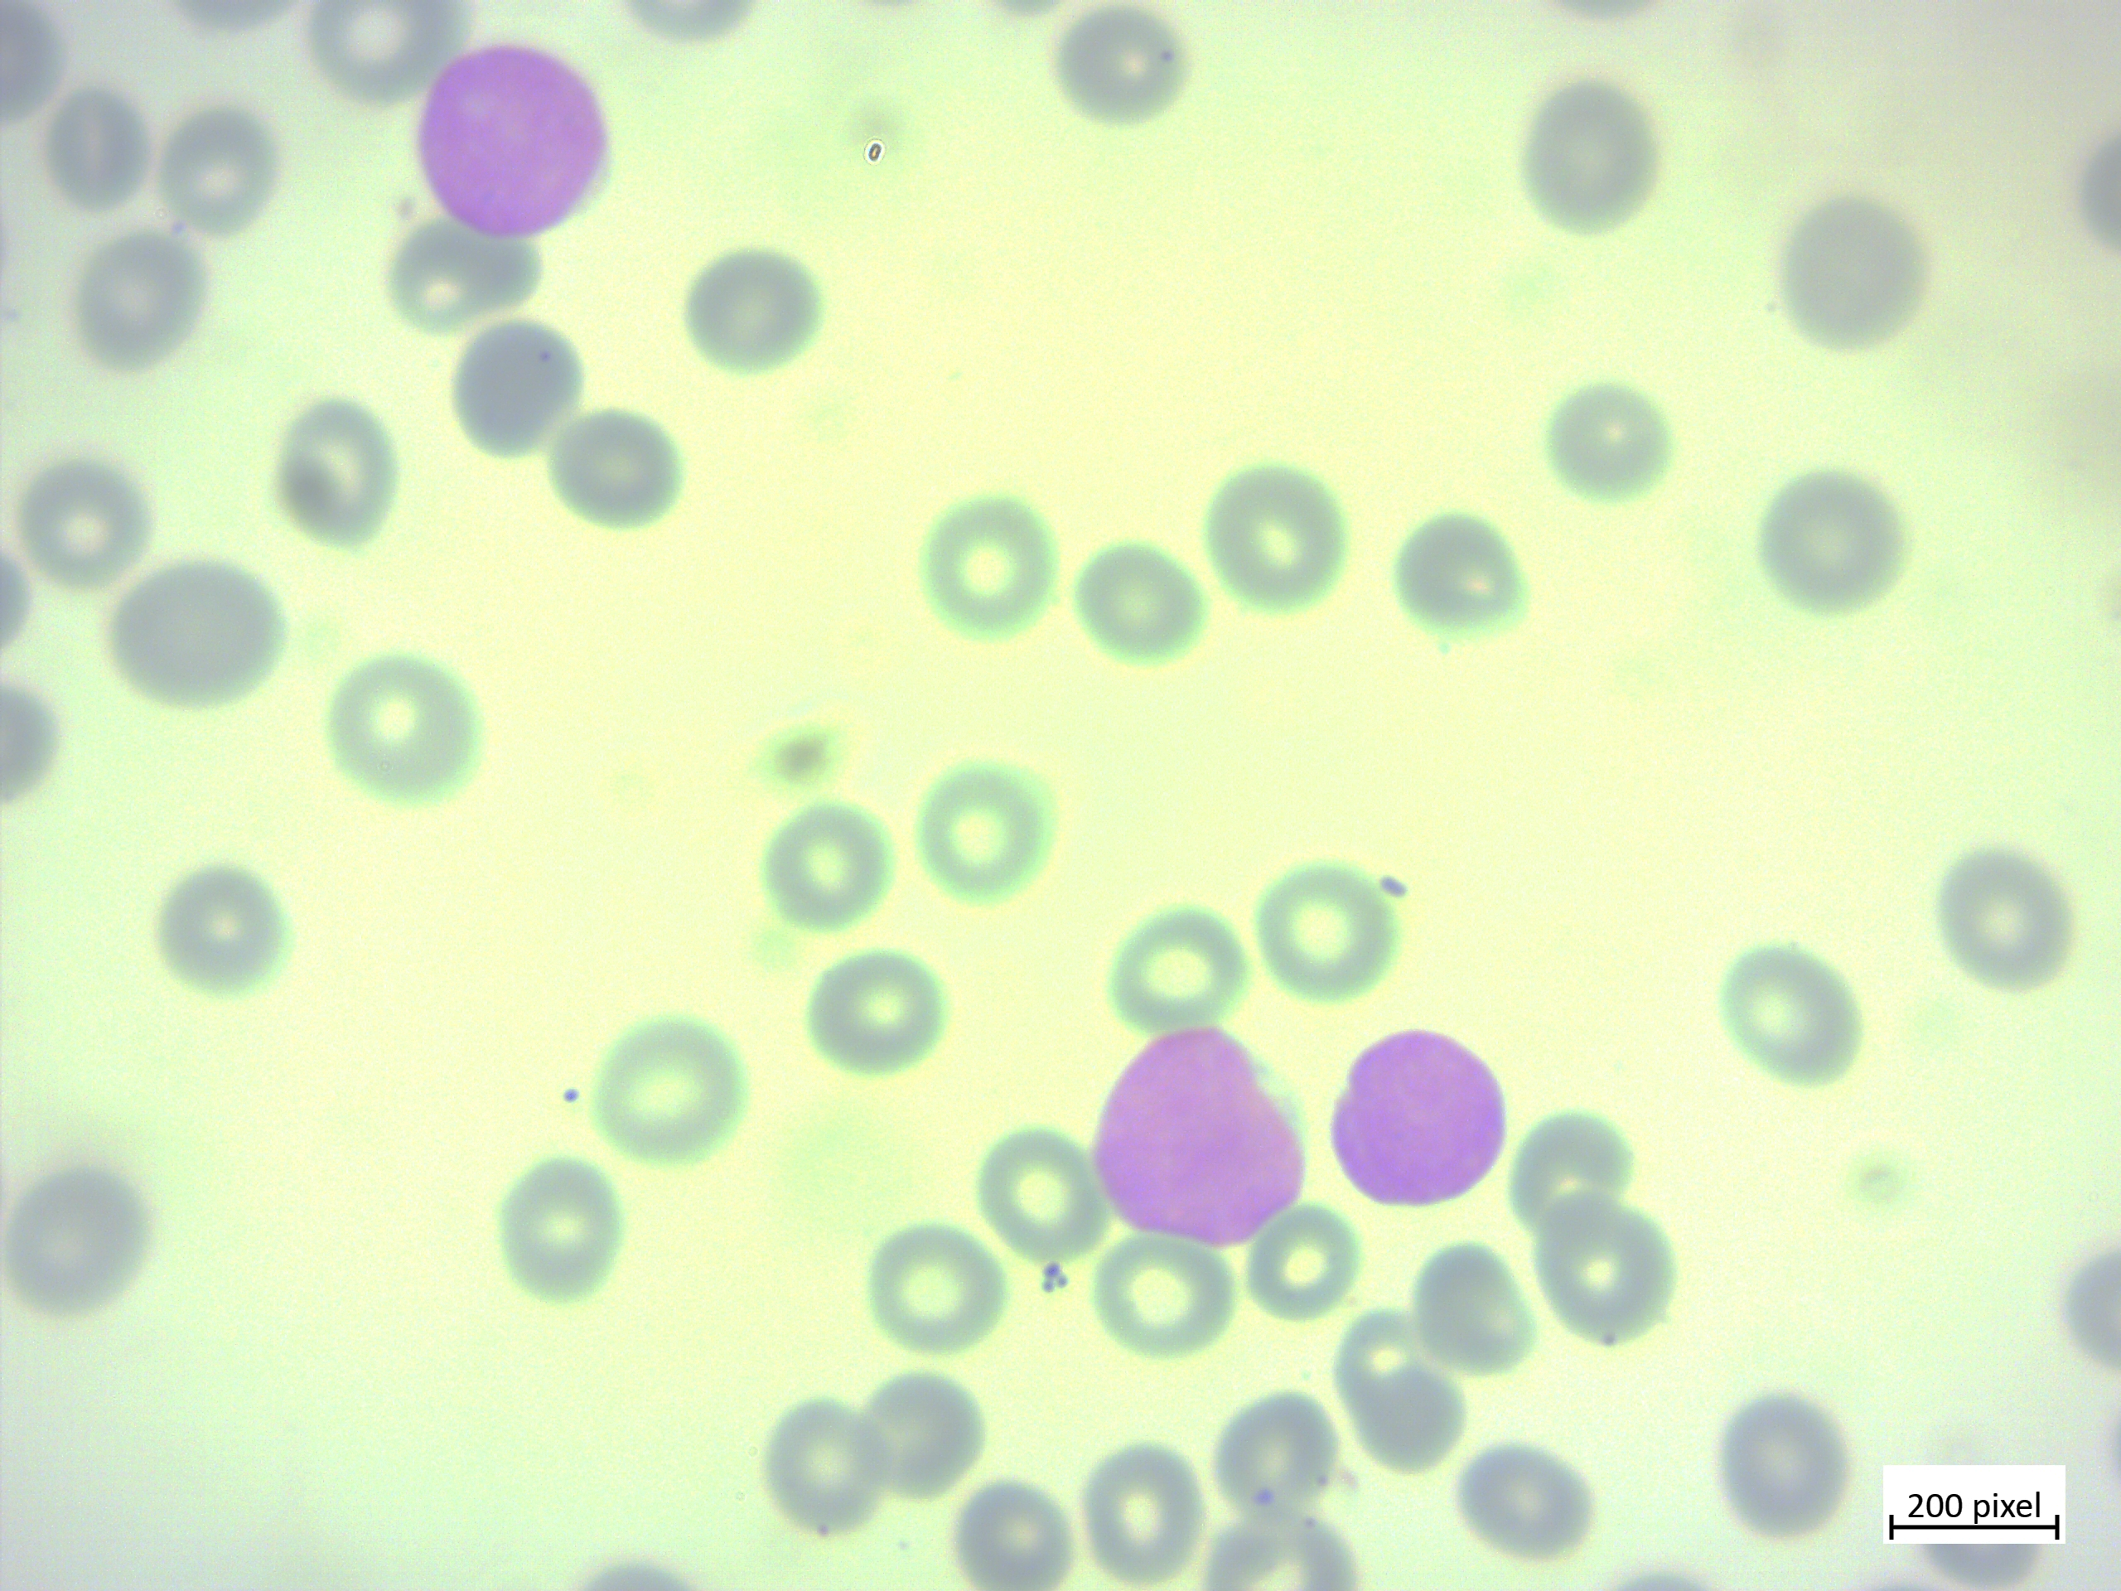
Hematoxylin-Eosin
Normalized
For All
Dataset
Training 70%
Preprocessing
Imbalanced
Microscopic
Blood Dataset
Augmentation
Balanced
Microscopic
Blood Dataset
Hematoxylin
Separated
Eosin
Separated
Validation 20%
Color-Threshold
Segmentation
Testing 10%
Resize: 224×224×3
Pixel Normalize to [0, 1]
GradCam++
Visualization
Input: 224×224×3
Proposed ResSplit-KAN Model
Training Augmentation
Stem Conv
Trained
Model
Res2 + SE Backbone (Multi-scale Residual)
Zoom 10%
Shear 5%
Brightness
Adjust [0.9, 1.1]
Vertical Flip
Height Shift 10%
Horizontal Flip
Rotation up to 180°
Width Shift 10%
KAN’s feature
Importance
visualization
CBAM Attention
KAN Layers
fill_mode = nearest

Slide 4
